Slide 1

A GLIMPSE INTO FIGURE SKATING EVENTS
Valeria Insogna, Cecilia Zagni
December 2022
Notes:
A glimpse into figure skating competions

Slide 2

INTRODUCTION
The dataset contains information about 17 major international events of figure skating, from October 2016 to December 2017.
Dataset source: https://github.com/BuzzFeedNews/2018-02-figure-skating-analysis

Slide 3
HOW DOES AN EVENT WORK?
In each event, junior and senior athletes compete. The athletes are divided in 4 categories compete: Ladies, Men, Ice dance, Pairs.
The competion has the same structure all over the categories.
Each one is composed by 2 programs: short and free.
Athlete(s) final score = short program score + free program score
Notes:
In each event, there’s a distinction between senior and junior competitions.
Each competes on 4 categories: Ladies, Men, Ice dance, Pairs.
Since didn’t find any difference between adults and juniors in terms of our analysis, we decided to group them both into the 4 categories.

Slide 4
HOW TO CALCULATE THE SCORES?
In each performance two types of aspects are judged: elements (i.e. jumps and spins) and components (i.e. interpretation of the music and skating skills).
Performance score = elements scores + components scores
Element’s score = base value + judge’s score
∈ [-3, +3]
Component’s score = factor * judge’s score
∈ [0.25, 10]

Slide 5

DATASET
Some of the main information considered after preprocessing are:
event
category
program
athlete_name
athlete_nation
element_base_value
total_element_score
total_component_score
judge_nation
rank
…
You can find the processed dataset and code here.

Slide 6
QUESTIONS ADDRESSED
Do the judges favor compatriot athletes?
Which athletes present the most difficult elements and how are they ranked?
Are elements more important than components in establishing the final ranking?

Slide 7
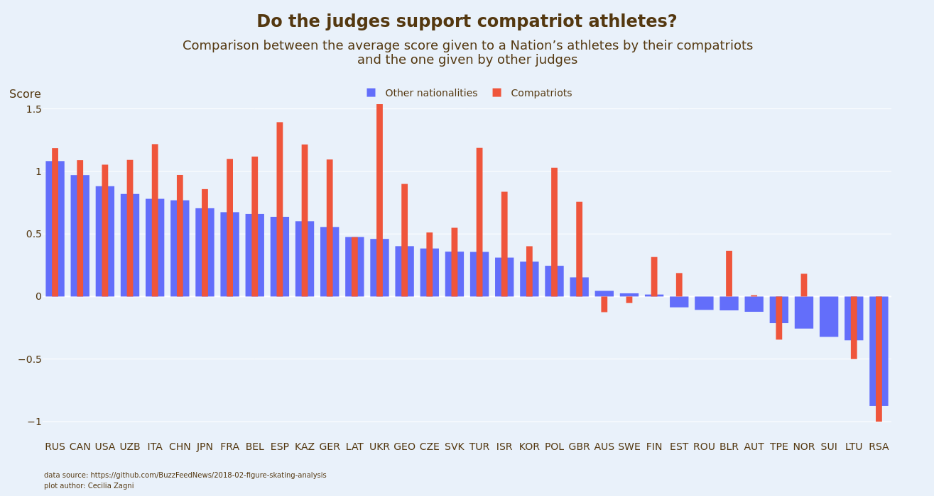
Notes:
In order to anwer to this question, we chose to consider only the element’s score, since elements are more obgective than components.
We also considered only the athletes who were judges by some compatriot judge to perform our computations.
As first, we coputed the average score given to each athlete (considering all the elements performed all over their performances) by the compatriots judges and the judges of other nationalities.
Then we averaged again to obtain the avrage score given to a nations’s athletes by bhe two categories of judges.
We chose to represent the results in this bar plot, where on the y axes is present the average score given by the judges (remember that they can give from -3 to +3).
The results are presented in decreasing order wrt the other nationalities score, in order to obtain aplasant visualization.
It is easy to see that for the majorty of the countries the average compatriot score is highes than the one given by other judges.

Slide 8
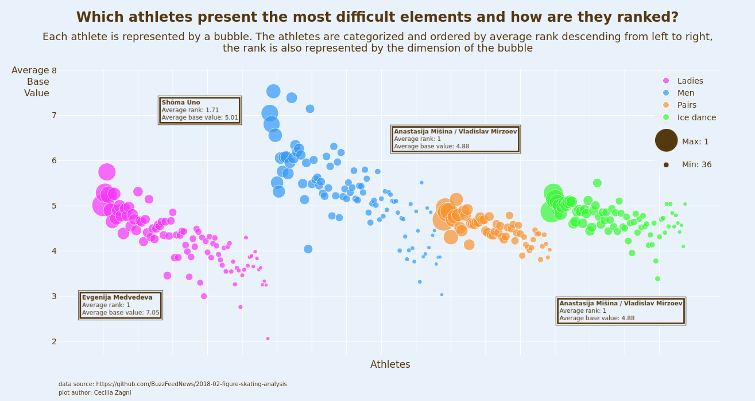
Notes:
To answer to this question, we computed the average ranking of each athete and, as a measure of difficulty, the average base value of the elements performed (all over the competition).
We chose to use a bubble plot to present our results, because we wanted to show several informations.
In this graph, each athlete is rapresented by a bubble.
On the x axes, the athletes are ordered by category, and by average rank descending (left right) within the categories. The rank is also represented by the dimension of the bubble.
On the y axes there is the average base value of the elements performed.
We can see that, as a general trend, the athlets that perform the most difficult elements are also the ones with the best rankings.
We choose to show the information regarding the best ranked athlet for each category.

Slide 9
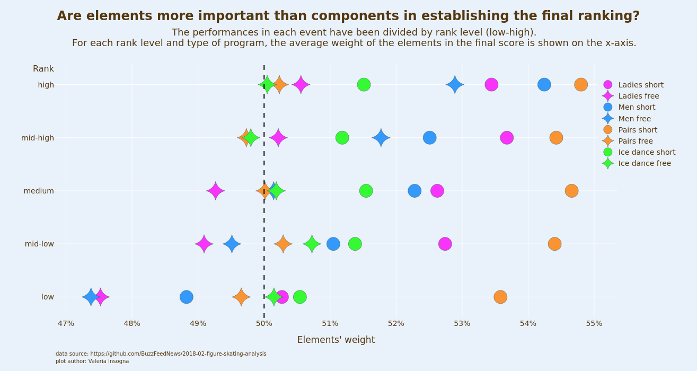
Notes:
To answer to this question, we considered all the performances of different programs for each category in all the events.
Let’s look at the y-axis: since the mentioned rank field varies in each program and category of each event, we decided to use a custom qualitative field (rank level) for this plot. It is obtained diving in 5 subdomains the values of the average obtained among all the performances in all events for each category of original rank value divided by the number of participants in that program of that event.
On the x-axis instead it is presented for each rank level and each category, the average (among all performances in all events) weight of the total element score in the final performance score.
Recall that a performance score in a program is obtained by the sum of the total element score and total component score. So it’s informative enogh to plot just the elements’ weight.
What can we deduce from this plot?
It’s pretty clear that the elements’ weight on average doesn’t vary so much around 50% inside a final performance score ( from 47% to 55%).
But anyway some patterns are visible: for example men performances (both in short and free programs) tend to be ranked lower when having less weight on total element score. and higher when having more weight on them (so in this case Elements play a crucial role in final ranking rather than Components).
For the Ladies this pattern is less but still visible, especially for the free program where lower level of ranking are associated with less than 50% of elements’ weight. Whilst for the Ladies short programs, on average elements’ weight are always above the threshold of 50% but still there’s the usual tendency of achiving the best rank level with the highest elements’ weight.
This slightly difference between Ladies and Men thus might be related to the fact that Components such as Interpretation of the music and Transitions are more important in the imbalance of votes for the Ladies performances. ( A lady may be judged more on such artistic aspects).
Looking at the other 2 categories, this tendency almost fades (lines are pretty verticals instead of obliques) but remains the propensity (which can be observed among all categories) that short programs tent to have higher elements’ weight rather than the ones: this might be related to the fact that free programs come first in a competion and serve to compose a first classification. Moreover they do not have which any specific rule on the elements to be presented.
So to sum up, defibetly elements are a key factor for the men and ladies program whilst for the pairs and ice dance this cannot be granted.

Slide 10
INDIVIDUAL CONTRIBUTIONS
Dataset preprocessing: Zagni.
Question brainstorming: Insogna, Zagni.
Question one data analysis and visualitazion: Zagni.
Question two data analysis and visualitazion: Insogna.
Question three data analysis : Insogna.
Question three visualitazion: Zagni.
Slides and refinements: Insogna, Zagni.

Slide 11
REFERENCES
https://github.com/BuzzFeedNews/2018-02-figure-skating-analysis
https://en.wikipedia.org/wiki/ISU_Judging_System#:~:text=The%20seven%20elements%20required%20of,spiral%2C%20and%20one%20step%20sequence.
https://www.usfigureskating.org/about/scoring-system
https://www.isu.org/figure-skating/rules/fsk-judging-system
11

Slide 12
LICENSE
Background image:
https://www.freepik.com/premium-photo/texture-blue-ice-surface-with-skate-scratches_5258233.htm (see premium license here).
12

